Slide 1






Main Features
File Based Record System:
No Internet Required:
Store and manage all your records locally as simple files—no complex databases needed.
Work offline anytime, anywhere without worrying about connectivity or data security.
No Microsoft Office or Excel Needed:
Beginner-Friendly and Fast:
Zamini_File_Manager
Forget about installing or using heavy office software; everything runs smoothly on its own.
Designed for everyone — easy to use, quick to learn, and efficient for daily tasks.
v1.0.0
P1
Notes:
https://unsplash.com/photos/woman-in-black-suit-jacket-QGr6H7pri-Q

Slide 2
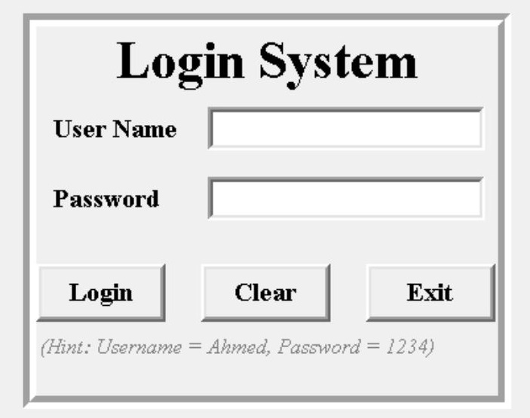
Login Page
Enter the username and password.
You can find login hints written below the input boxes.
Click Login to continue.
✅ Optional: Mention default login (if it's like “Ahmed" / "1234")
Login
Clear all
Exit
User Name: Ahmed
Password: 1234
It will reset entries
Close Window
P2
Notes:
https://unsplash.com/photos/woman-in-black-suit-jacket-QGr6H7pri-Q

Slide 3
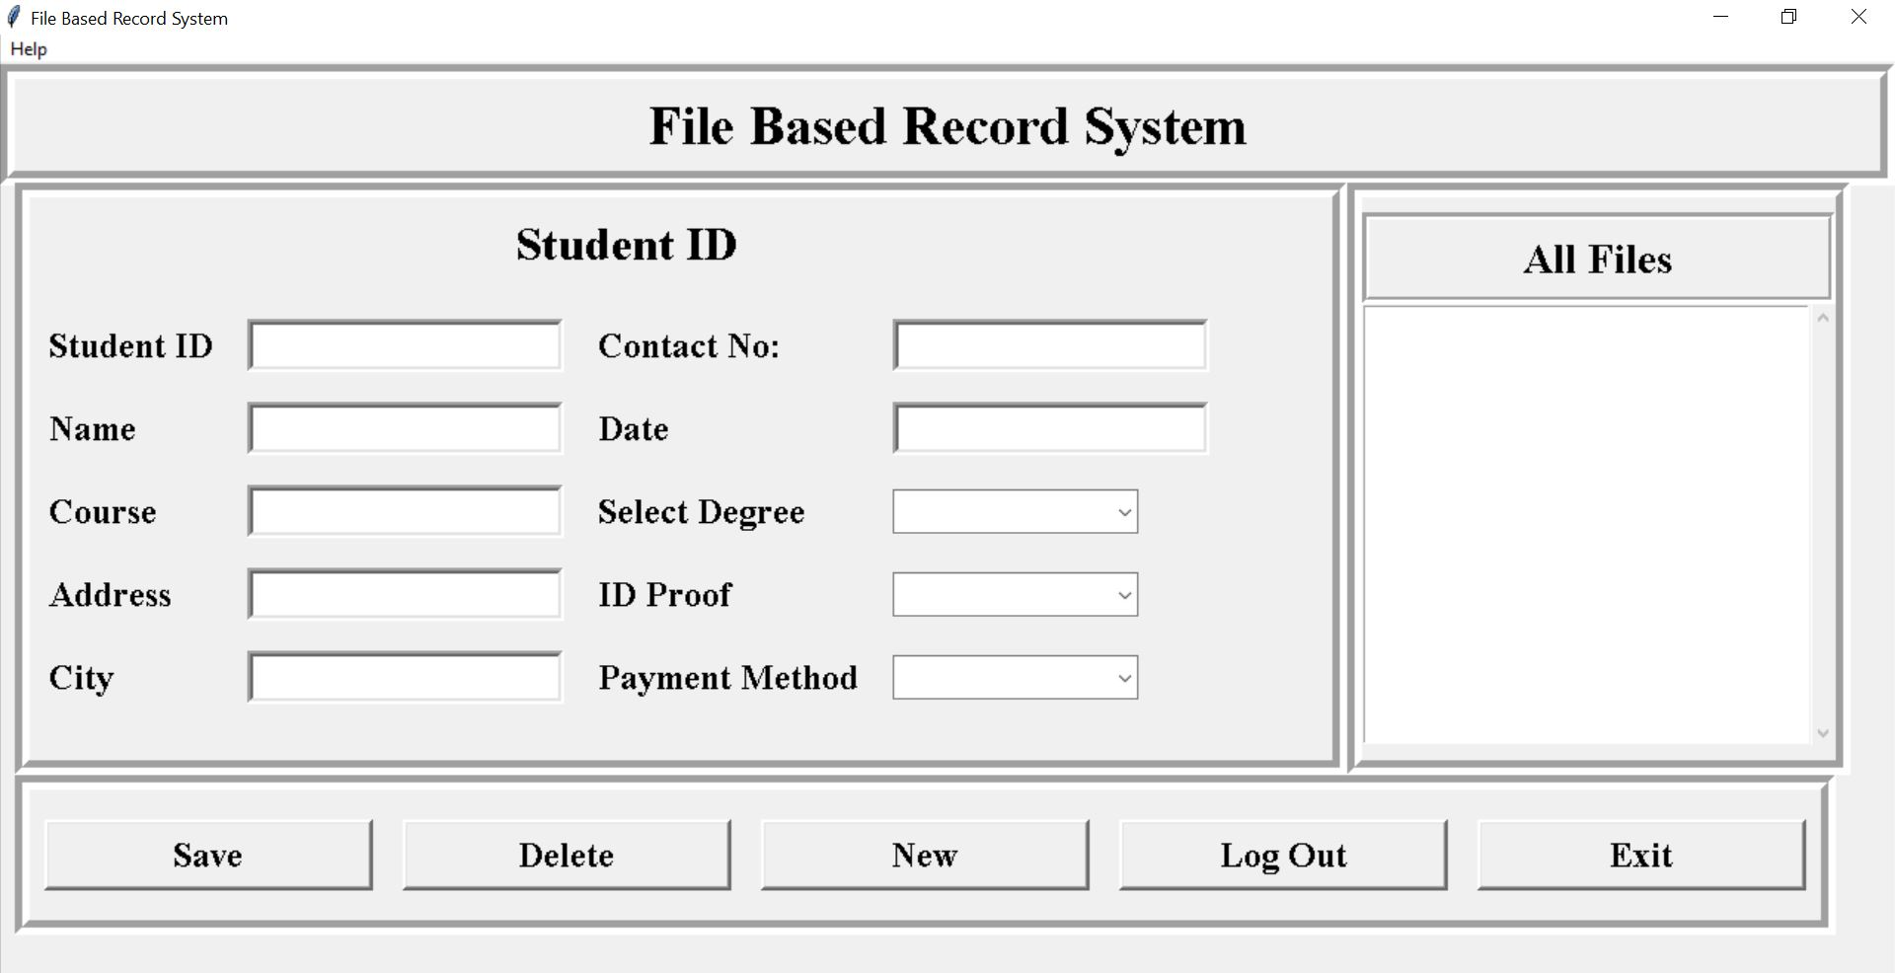
How It Work
After login, access the main file operations like creating, editing, and saving.
Step 1: Entry Fields
Step 2: Click Save
Step 3: View all Files
You can enter your data here in these fields
then Move to Step 2.
Click save button to save data
Check here to see all your data as student ID wise.
This will be save as text file in “File” folder in same directory where Zamini_File_Manager_v1.0.0.exe is.
P3
Notes:
https://unsplash.com/photos/woman-in-black-suit-jacket-QGr6H7pri-Q

Slide 4
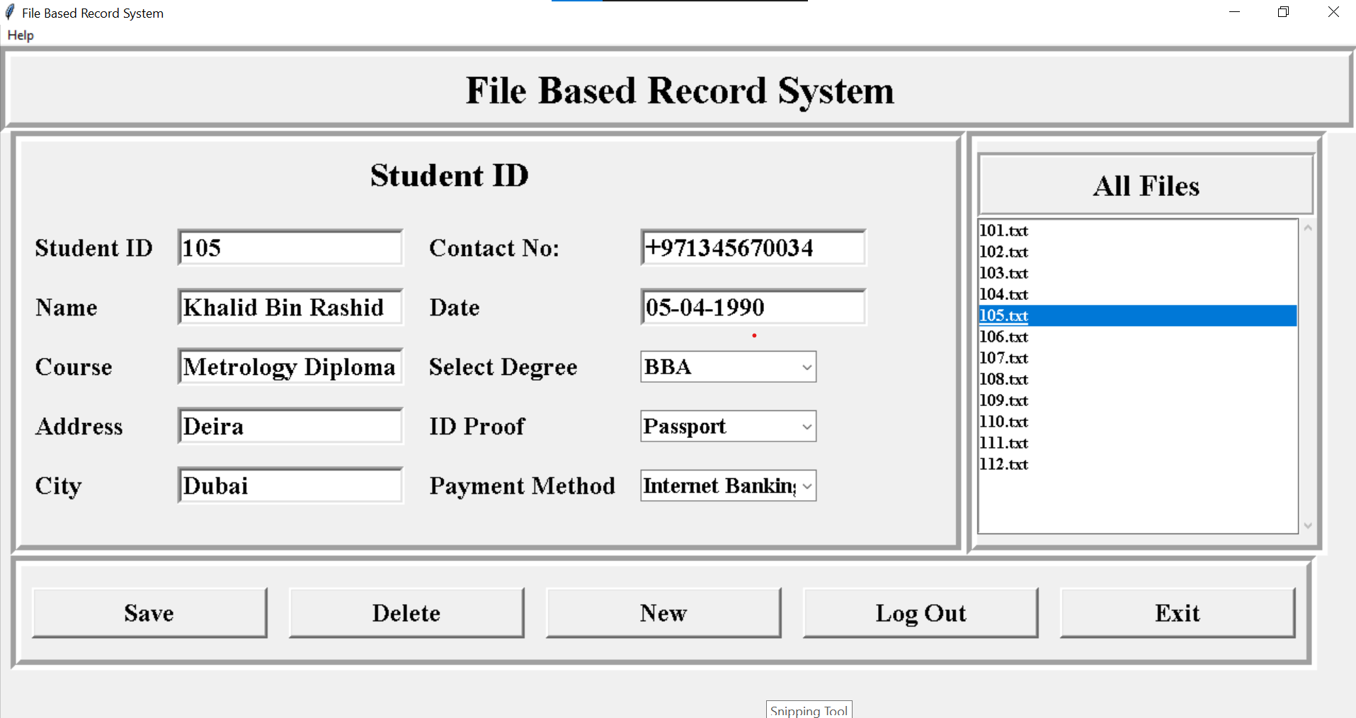
Extra Features
You can delete, add new, exit also you can get help anytime from help section or contact use from there.
Edit and save
Get help or contact us
Delete current Record
Clear all form
Logout to login window
Exit All
You can open and edit then click save the current record for update the record
P4
Notes:
https://unsplash.com/photos/woman-in-black-suit-jacket-QGr6H7pri-Q

Slide 5
Zamini Musafir زمینی مسافر
(Tour of the Universe)
SUBSCRIBE NOW
@Zamini.Musafir123
Notes:
https://unsplash.com/photos/woman-in-black-suit-jacket-QGr6H7pri-Q

